Slide 1
Habitat destruction and overcropping

Slide 2
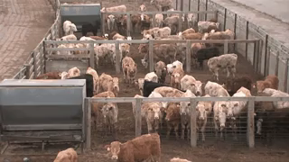
By the end of the lesson, you should be able to:
1. | Identify the main cause of habitat destruction in Australia.
2. | Describe the impacts of overcropping.
3. | Propose ways to reduce the negative impacts of human activity on ecosystems.

Slide 3
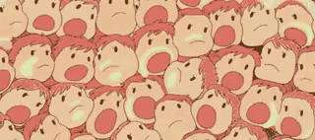
Although humans are just one species, we're a species that has grown rapidly and spread around the globe.
There are now over 7 billion humans on Earth, and each and every one of us puts strain on the environment.

Slide 4
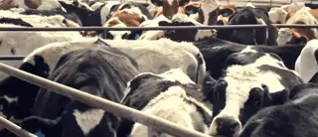
We need a lot of food to feed 7 billion humans!
However, our current agricultural techniques are not sustainable.
Our rate of consumption of meat and dairy products is putting too much stress on the environment. Animal agriculture, in particular, is resource intensive, causes much pollution, and has required vast amount of land to be cleared.

Slide 5
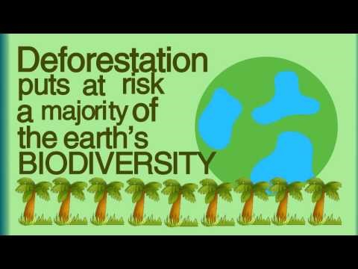

Slide 6
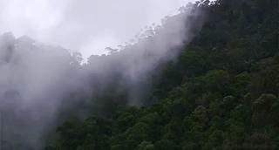
We like to think that rainforests are something exotic, that exist too far away for us to be concerned about.
In fact, functioning rainforests are so important that we, and most other life on Earth, could not survive without them!

Slide 7
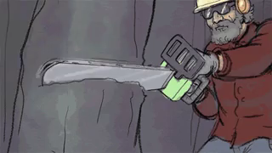
Habitat destruction has negative effects on ecosystems.
Habitat destruction removes important producers from ecosystems, which changes the way that energy flows through the system. It also removes shelter and alters the conditions for consumers and decomposers.
If the ecosystem is altered too much by habitat destruction, it can fall apart or collapse!

Slide 8
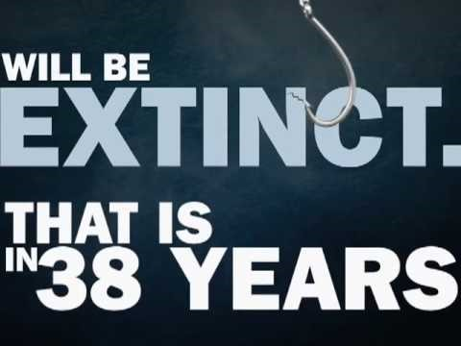

Slide 9
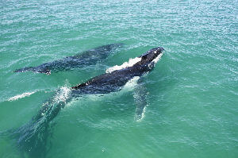
For many decades, various whale species were hunted for meat, fat and other products.
This practice is known as whaling.
Ecologists became concerned when they observed whales becoming less common. In the 20th Century, they finally realised that whales were being killed faster than they could reproduce.

Slide 10

Ecologists play an important role when it comes to controlling overcropping, because their research is what allows new laws and regulations to be passed.
These regulations help to ensure that overcropping does not occur.
For example, in the last few decades there have been many regulations against whaling. As a result, whale species that were on the edge of extinction are starting to recover and regenerate.

